Slide 1


Making Effective Referrals: A CSCP Guide
Supporting Effective Multi-Agency Referrals in Croydon

Slide 2
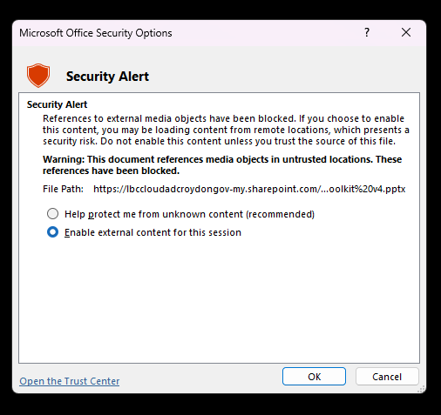
Contents
This toolkit is designed for:
Practitioners making referrals as part of their role
Members of the public or volunteers seeking guidance on raising concerns
New starters completing safeguarding induction
Organisations wanting to strengthen internal safeguarding procedures
Any professional working with or supporting children, young people, or families in Croydon
Introduction & Purpose 
Section 1: The Multi-Agency 
Responding to concerns
Family Hubs
Early Help Directory
The role of CSCP
The Multi-Agent Safeguarding Hub (MASH)
Section 2: Identifying Concerns 
  What is a referral
  The Continuum of Need
  Identifying concerns
  Threshold Guidance
  Consent
  Legislation
Section 3: Making an effective referral 
  Submitting a referral
  Information required for a referral
  Case studies
  Key things to remember
  Professional curiosity
Section 4: Post referral 
Further reading and resources 
  Service Glossary
  Resources
  CSCP Contact
This resource contains videos, to view them select enable content when prompted in presentation mode.

Slide 3

Introduction & Purpose
The Referral Guidance Toolkit has been developed by the Croydon Safeguarding Children Partnership (CSCP) to support all professionals working with children, young people, and families. Its purpose is to help practitioners make clear, timely, and effective referrals when concerns arise, ensuring that children receive the right support at the right time.
This guidance has been designed to build a shared understanding and confidence across health, education, police, social care, and voluntary, faith, and community organisations. It serves both as a practical reference for experienced professionals and as a refresher to strengthen good practice. By promoting consistent understanding and application of thresholds, harm, need, and risk, the toolkit supports practitioners to make effective, well-informed decisions that will safeguard children.
Importantly, the toolkit also serves as an onboarding resource for new starters. Even if an individual’s role does not involve making referrals directly, it is vital that everyone working with children and families understands how the process works. Knowing what a referral is, why it matters, and how it contributes to safeguarding ensures that regardless of your role, we are all working together to safeguard children.

Slide 4
Section 1: The Multi-Agency

Slide 5
Responding to concerns about a child or family
Worried about a child or family
Is there an immediate risk of significant harm
Call 999
Yes
Quick Reference: Referral Decision Flowchart
This flowchart is designed to support practitioners in deciding what action to take when they have a concern about a child. It helps ensure a consistent and proportionate response across agencies in Croydon.
Key reminders:
A referral is never wrong if it’s made in good faith and based on genuine concern.
Quality matters - provide as much relevant, factual information as possible.
Remember to follow up on your referral to confirm it has been received and progressed.
No
Assess the level of concern using the Threshold Guidance
Familiarise yourself with this guidance
Discuss with your DSL/Manager (if applicable)
Record facts, observations and quotes
Seek consent from parents/carers (unless unsafe)
Before making a referral gather and record information
Referrals
Consider Early Help Directory
Signpost support from the Family Hub
Offer advice or practical help where appropriate
Does the concern suggest significant harm or ongoing neglect?
Contact MASH for advice or to make a referral.
Use the online portal and follow up by phone if urgent.
Referrals reviewed within 24 hours, progressed within 48 hours.
No
Yes
Follow up and reflect
After submitting a referral, check progress with your Designated Safeguarding Lead (DSL) or MASH to confirm next steps. Record all actions and outcomes securely. Continue to review the child’s situation and escalate if concerns remain. Keep parents/carers informed of your actions (unless doing so would place the child at risk) — engagement should be done with families, not to them.

Slide 6
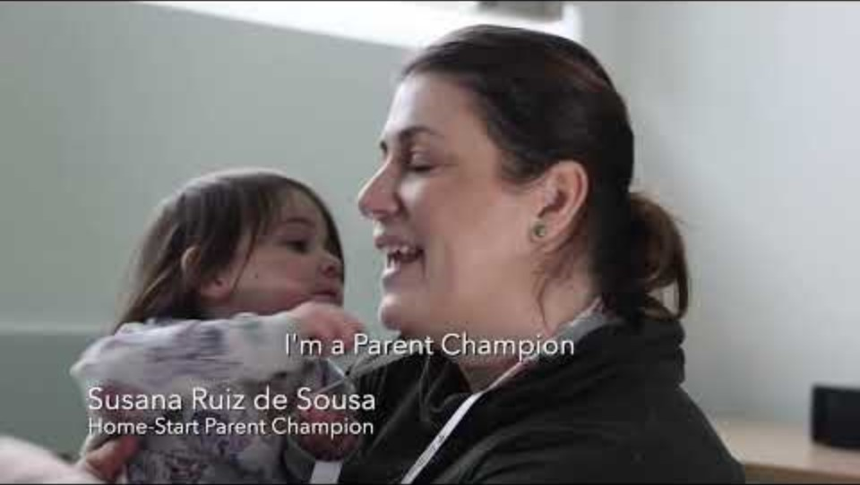

Family Hubs  are a UK government initiative designed to provide integrated support for families, particularly during the critical early years of a child's life. They are part of the Family Hubs and Start for Life programme, jointly led by the Department for Education and the Department of Health and Social Care.
Purpose and Vision
Family Hubs aim to:
Join up and enhance services across local authority areas.
Ensure all families can access the support they need, when they need it.
Improve health and education outcomes for babies, children, and families.
Reduce inequalities in access to services and outcomes.
What Family Hubs Offer
They serve as local one-stop shops where families can access a wide range of services, including:
Parenting advice and courses.
Health services such as midwifery, health visiting, and infant feeding support.
Support for children with SEND (Special Educational Needs and Disabilities).
Emotional and behavioural support.
Financial, housing, and welfare advice.
Early education and childcare guidance.
Domestic abuse and substance misuse support.

Slide 7
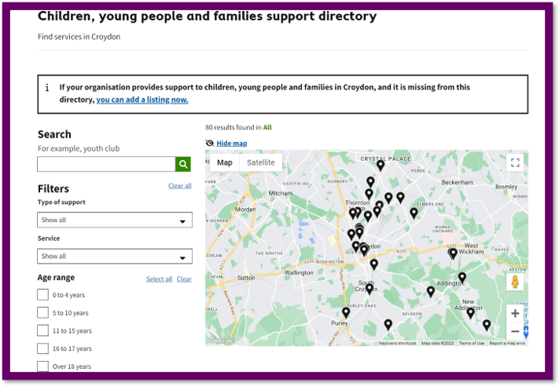
Helping families to help themselves
The Children, Young People and Families Support Directory is for families and professionals. It might be all a family needs is a supportive signpost to a local service who can help.
The services may include support around:
community and voluntary groups
crime and youth justice
domestic violence and abuse
employment, education and training
health and wellbeing
housing and homelessness
parenting and childcare
social, community and leisure activities
special educational needs and disabilities
Children, young people and families support directory | Croydon Council 

Slide 8



The Role of Local Safeguarding Partnerships
The Croydon Safeguarding Children Partnership (CSCP) brings together the local authority, health, and police as statutory partners under the Children Act 2004. The partnership also works closely with education - recognised as a core agency though not a statutory partner - alongside voluntary and community and faith organisations to ensure strong and effective safeguarding arrangements are in place across Croydon.
Through this collective effort, the CSCP ensures that:
Agencies share information openly and effectively.
Thresholds for support are understood and applied consistently.
Children are safeguarded from harm, and their welfare is actively promoted.
Making effective, well-evidenced referrals is central to this shared responsibility, ensuring that children and families receive the right support at the right time.
Working together and ensuring effectiveness of safeguarding arrangements
Multi-agency practice and procedures
Safeguarding Practice Reviews and Child Death Reviews
Multi-agency
safeguarding
performance
Thematic multi-agency audits
Multi-agency learning and development

Slide 9
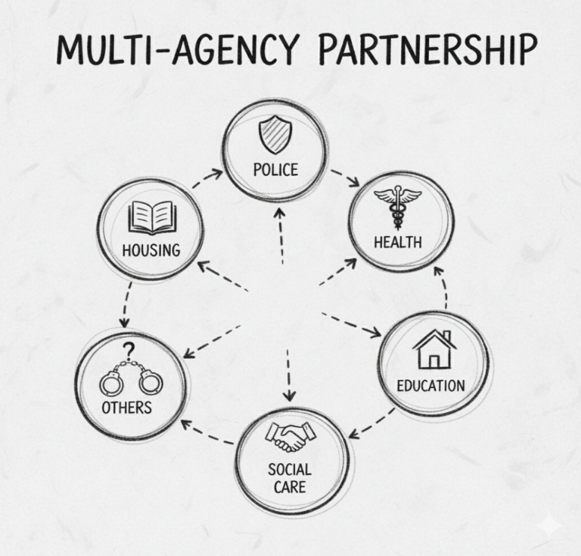
How MASH works in Croydon
The Multi-Agency Safeguarding Hub (MASH) is Croydon’s single point of contact for all safeguarding concerns. It brings together key professionals from Social Care, Police, Health, Education, Probation, Housing, and other services to share information, assess risk, and make decisions that protect children.
All referrals are routed through MASH, where agencies collaborate daily to ensure a swift and proportionate response.
All referrals MUST be made via the Online Portal 
All contacts received by MASH are reviewed and actioned within 24 hours, with a further 48 hours to progress the referral to the appropriate service or team.
When making a referral, please ensure you have nominated someone who can respond to follow-ups in your absence. This helps prevent delays and ensures continuity if additional information is needed.
Office Hours (Mon–Fri, 9am–5pm)
Call 0208 255 2888
If accepted by phone, complete online referral form within 24 hours
Out of Hours
Call 0208 726 6400, press 5 for Children’s Services
Stay on the line until transferred to the duty social worker
If you can’t get through, email: SSD-EMERGENCY-DUTY-TEAM@croydon.gov.uk
The Out of Hours Team responds to urgent safeguarding concerns that cannot wait until the next working day.
MASH
If you have an urgent concern about a child that needs an immediate response, consider calling 999 and request the appropriate emergency service.

Slide 10
Section 2: Identifying Concerns

Slide 11

What is a Referral?
A referral is when a professional shares concerns about a child’s welfare or safety with the Croydon Multi-Agency Safeguarding Hub (MASH).
Referrals should always consider the London Child Protection Procedures (LCPP) Threshold Guidance, ensuring the level of concern is clearly evidenced and proportionate.
A referral may be made when there are:
Observed signs of harm or risk of harm.
Concerns about neglect, abuse, or unmet needs.
Escalations from Early Help or other support services where needs have increased.
MASH’s role is to receive, triage, and allocate referrals to ensure children and families receive the right help at the right time.
Please note that the MASH telephone line is for referrals only. It should not be used for general enquiries or case updates. Follow-ups and progress checks should be directed through your organisation’s Designated Safeguarding Lead (DSL) or safeguarding contact to help MASH keep lines clear for urgent safeguarding matters.

Slide 12
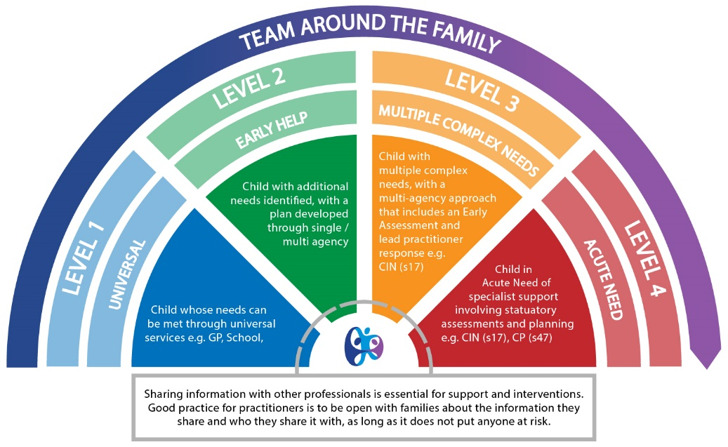
The Continuum of Need
The Continuum of Need Shield is a framework used across London to help professionals decide what level of support a child and family may need. It sets out four broad levels of need and risk and shows how children can move between these levels at different times in their lives.
Level 1 – Universal (No additional needs):
  Children’s needs are met by universal services such as schools, GPs, Health Visitors, Family Hubs and Community support.
  Example: a child is healthy, attends school regularly, and has supportive parents.
Level 2 – Early Help (Additional needs):
  Some emerging worries, but needs can be addressed with targeted support.
  Example: a family struggling with housing or parenting support may benefit from Early Help or Family Hub services.
Level 3 – Child in Need (Complex needs):
  The child has multiple or more serious needs that require a statutory Children’s Social Care assessment under Section 17 of the Children Act 1989.
  Example: a child with ongoing neglect concerns, or who needs coordinated multi-agency support.
Level 4 – Child Protection (Acute needs):
  The child is at risk of or is experiencing significant harm, requiring urgent statutory intervention under Section 47 of the Children Act 1989.
  Example: a child experiencing physical abuse, sexual abuse, or severe neglect.

Slide 13

Identifying Concerns
Before making a referral, it’s essential to be clear about what you are worried about, why it matters, and what you want to happen next. This helps ensure MASH can understand the situation, apply thresholds correctly, and respond quickly.
The London Safeguarding Children Procedures (LSCP) provide the framework for thresholds of need across London. Not all professionals will be familiar with these, especially in smaller or community organisations — but it’s important to engage with them, as they help determine the right pathway for support.
Why it matters
The continuum of need shield encourages professionals to think proportionately - matching the right level of support to the child’s needs. It helps ensure consistency across agencies in Croydon.
Importantly, children may move up or down the shield over time, so concerns should be reviewed regularly. Knowing the shield helps professionals, including those in smaller organisations, understand when to provide support directly, when to signpost to Early Help, and when to refer to MASH.
When identifying concerns, link your referral to thresholds:
What are you worried about? (Level of risk/need)
What is the impact on the child? (Immediate or longer-term)
What is working well? (Protective factors)
What needs to happen next? (Desired outcomes/support)
Relevant Guidance:
Children Act 1989; Section 17 
Children Act 1989; Section 47 
London Safeguarding Children Procedures 
CSCP Guidance for Professionals 

Slide 14
Threshold Guidance
Importance of Threshold Guidance:
Clarity and Consistency: Ensures all professionals, such as social workers, teachers, and healthcare providers, have a shared understanding of the signs and severity of harm.
Appropriate Response: Helps allocate the right level of resources and support based on the child's needs and risks.
Multi-Agency Collaboration: Facilitates coordinated efforts across organisations like schools, healthcare, community services and law enforcement to safeguard children effectively.
Threshold Guidance in children's safeguarding refers to a framework or set of criteria that helps professionals determine the level of support or intervention required to address concerns about a child's safety and well-being.
It ensures a consistent and shared understanding across agencies about when and how to act to safeguard a child.
Notes:
By adhering to threshold guidance, professionals can make informed decisions about when to escalate concerns, provide early support, or involve statutory services to protect a child.

Slide 15
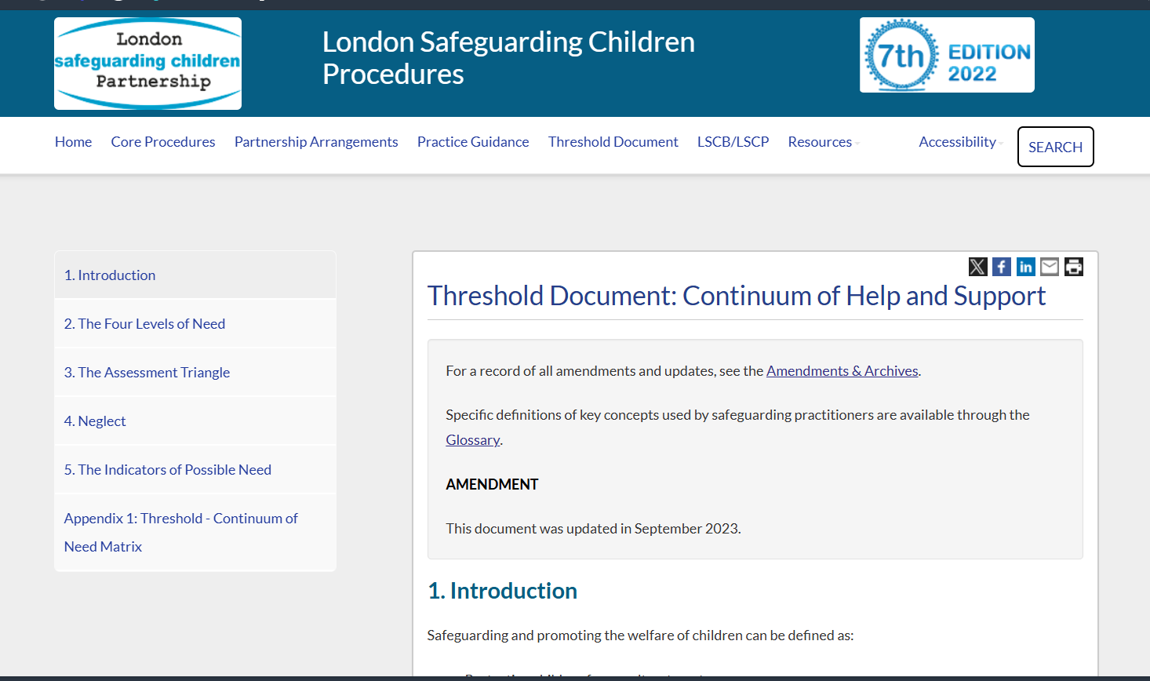
What is the "Threshold Continuum of Need" Page?
This is the official London Safeguarding Children Procedures online document that hosts the Threshold Matrix. It's your essential, go-to reference for making consistent and informed decisions about a child's welfare.
Why You Need to Use It:
A Common Framework: It provides a single, shared language for all agencies—from education and health to police and social care—to discuss and assess a child's needs.
Objective Decision-Making: The matrix helps remove subjectivity by outlining clear indicators of need at each level, supporting your professional judgement.
Critical for Referrals: It is the benchmark against which all referrals to the MASH (Multi-Agency Safeguarding Hub) are assessed. Using it ensures your referral is appropriately targeted and contains the right information.
Bookmark This Essential Resource Today:
https://www.londonsafeguardingchildrenprocedures.co.uk/thresholds.html

Slide 16
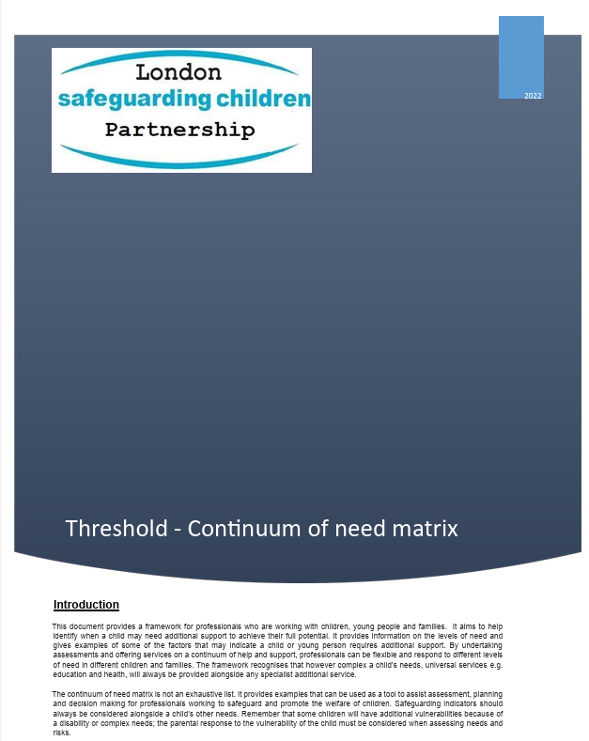
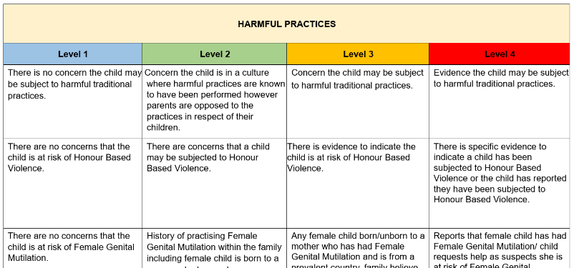
Download a copy of the matrix:
https://www.londonsafeguardingchildrenprocedures.co.uk/files/threshold.pdf
How to Use It in Practice:
Assess: When you have a concern, use the matrix to compare the child's circumstances against the detailed descriptors for each level (Universal, Early Help, Child in Need, Child Protection).
Identify the Level: Pinpoint which threshold best matches the child's situation. This will clarify the most appropriate pathway for support.
Outcome of assessment | Action
Level 2 | This indicated an Early Help / Family Hubs response. You lead on a completing an Early Help Assessment and forming a Team Around the Family. This level does not require a referral to the MASH.
Level 3 | A level 3 or 4 indicates a need for Children’s Social Care involvement. This is your trigger to make a referral to the MASH using the Threshold Guidance and Continuum of Need matrix to support your professional judgment — not replace it. Professionals are encouraged to be descriptive rather than prescriptive: provide clear, contextual information that reflects the child’s unique circumstances rather than copying indicators directly from the matrix. This ensures MASH can accurately assess the nuances of need, harm, and risk.
Level 4

Slide 17
“Getting consent prevents me from sharing information”

Slide 18
Working Together to Safeguard Children 2023
The guidance says,
“The Data Protection Act 2018 and UK General Data Protection Regulation (UK GDPR) supports the sharing of relevant information for the purposes of keeping children safe. Fears about sharing information must not be allowed to stand in the way of safeguarding and promoting the welfare of children.”
“.. all organisations and agencies should have arrangements in place that set out clearly the processes and the principles for sharing information. The arrangements should cover how information will be shared with their own organisation/agency and with others who may be involved in a child’s life.”
“.. The legal bases that may be appropriate for sharing data in these circumstances could be “legal obligation” or “public task”, which includes the performance of a task in the public interest or the exercise of official authority.”
Relevant Guidance:
Working Together to Safeguarding Children: Information Sharing 
The Data Protection Act 2018 
General Data Protection Regulation (UK GDPR) 
Notes:
"As professionals working with children and vulnerable people, it's important to understand how data protection laws support safeguarding efforts.
The updated guidance clarifies that UK GDPR allows the sharing of personal information when there's a legal basis for doing so. Consent is not always required, but when it is used, it must meet specific conditions: it should be clear, limited in scope, and revocable. Remember, different legal bases come with different rules, so it’s crucial to understand which one applies in each situation.
Under the Data Protection Act 2018, information can be shared to protect children or vulnerable people, even without consent, if it is for safeguarding purposes or promoting the child’s welfare. For example, you might share information without consent if there’s a legal obligation or it aligns with a public task.
While sharing information, it’s also important to keep parents or carers informed about what is being shared and why. Collaboration is key, but if informing them poses a safety risk to the child, you may need to act without their knowledge.
This guidance emphasizes balancing the need to protect children with the principles of lawful and responsible information sharing."

Slide 19
Section 3: Making a Referral

Slide 20

Why effective referrals matter
Safeguarding is a shared responsibility – no single agency can protect children alone. Strong referrals ensure that:
Concerns are clear and evidence-based.
Thresholds are applied consistently across Croydon.
Children and families receive the right support at the right time.
The London Safeguarding Children Procedures (LSCP) set out the thresholds of need that guide whether support should be provided through Early Help, as a Child in Need, or through Child Protection processes.
It is important that all professionals - including those in smaller organisations - become familiar with these thresholds and revisit them regularly. The LSCP is updated periodically to reflect changes in law, guidance, and learning from safeguarding reviews. Keeping up to date helps ensure referrals are not only appropriate but also aligned with the most current safeguarding standards.
Making effective referrals is therefore a key part of fulfilling your statutory safeguarding duties and contributing to a safer Croydon for children and families.

Slide 21
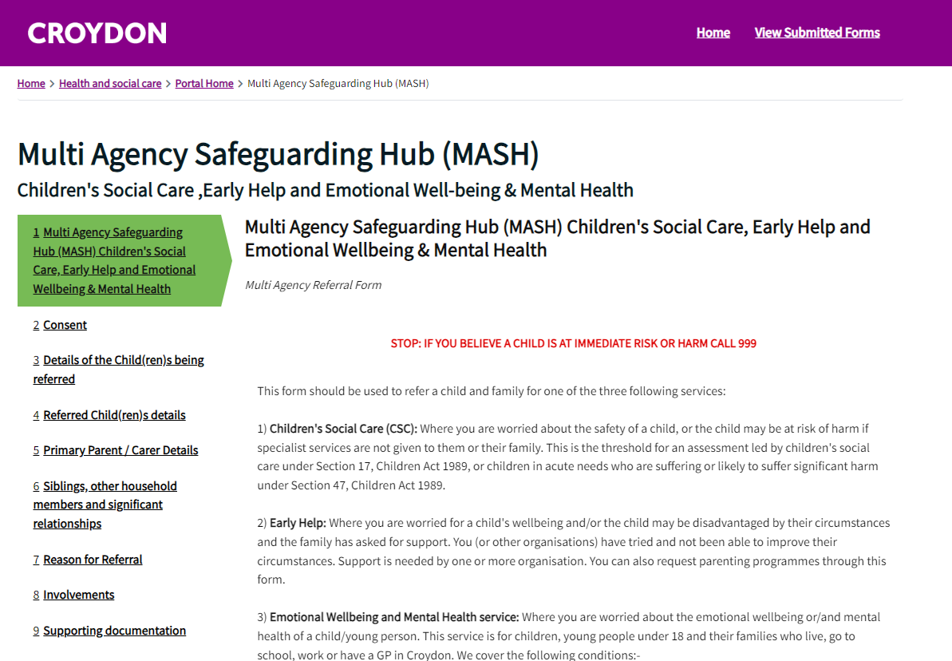
MASH Portal
Submitting a Referral
DO NOT SEND REFERRALS VIA EMAIL!
All referrals should be submitted via the Croydon MASH Portal 
Requests for information should be submitted via: Croydon MASH information 
Please note if you are:
wishing to speak to or leave a message for a child’s allocated social worker, you need to contact them directly. Emails into the MASH email inbox will not be responded to.
a professional and you are enquiring as to whether a child has an allocated social worker, please contact your Designated Safeguarding Lead who will be able to find out this info for you.
waiting to find out who a child's allocated social worker is, please contact: intakebusinesssupport@croydon.gov.uk Your email into our MASH email inbox will not be responded to.
If you are seeking guidance on how to make a referral or other services that can support a child or their family, please visit: Concerned about a child? | Croydon Council 
The Portal provides a referral pathway for Children’s Social Care, Early Help and Family Hubs.
Croydon MASH - Referral Form

Slide 22
The Referral
For the Croydon MASH to assess and progress a referral effectively, it is essential that professionals provide as much relevant information as reasonably possible. The complete and more accurate the information, the better MASH can understand the child’s situation, assess the level of need, and ensure the right support or protection is put in place without delay. The following details are required when making a referral.
Consent
Details of the child being referred
Additional demographic information
Primary Parent/Carer details
Siblings and other household relationships
Reason for referral
Involvements
Supporting Documentation
The child’s race, ethnicity and language is a crucial part of the referral.
What are you and/or the child/family worried about?
What is the impact on the child or young person?
What is working well for this child and in this family?
What do you want to happen next?

Slide 23
Information Required for a Referral
Category | What this means | What should be provided
Consent | Whether the parent/carer (and child, if appropriate) has been informed of the referral and has given permission. Note exceptions if seeking consent would place the child at risk. | “Parent informed and agreed to referral” / “Consent not sought due to risk of further harm if parents informed.”
Details of the child being referred | Full and accurate personal details of the child. | Full name, date of birth, address, gender, school/nursery attended.
Additional demographic information | Information that helps understand the child’s identity and needs. | Ethnicity, first language, religion, disability/SEND.
Primary parent/carer details | Details of the main caregiver(s). | Name, address, relationship to child, telephone number(s), email. This should include preferred method of contact,
Siblings and other household relationships | Who else lives in the home or plays a significant caring role. | Sibling names/ages, other adults in the household, extended family members.
Reason for referral | Clear statement of the concerns, including evidence and impact on the child. | “Child disclosed being left home alone overnight. Neighbours reported hearing crying late at night.” / “Child appeared unwashed and wore the same clothes for several days.”
Involvements | Professionals and agencies already working with the child/family. | GP, Health Visitor, CAMHS, School, Family Hubs, Community Sector Services.
Supporting documentation | Any records or evidence that supports the concern. | Chronology of incidents, attendance records, medical notes, photos of injuries (if applicable and in line with policy). Additionally, any type of assessments that have already been carried out.

Slide 24
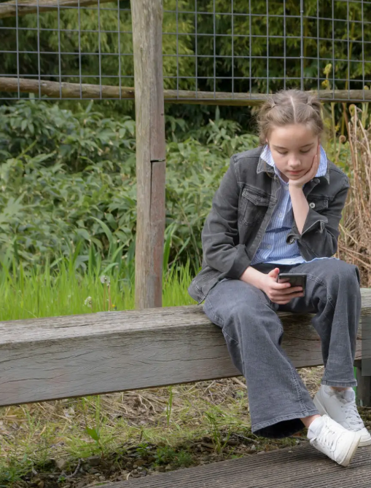
Referral Case Studies
Real-world examples can help us see the difference between a poor-quality referral and a well-constructed one. The following case studies highlight how the clarity, detail, and accuracy of information provided can directly influence how concerns are understood, assessed, and acted upon by MASH and partner agencies.
By comparing poor and good referral practice side by side, we can reflect on the importance of professional curiosity, clear evidence, and anti-racist inclusive recording. These examples are designed as both learning tools and discussion prompts, encouraging all practitioners to think carefully about the information they provide and how it can affect outcomes for children and families.
Objective:
By the end of this section, you will be able to recognise the features of an effective referral and understand how the quality of information impacts safeguarding outcomes.

Slide 25
Referral Example A
Consent:
Not discussed with mum yet.
Details of the child being referred:
Boy, 7, called Jay. Goes to St Marys
Additional demographic information:
Black. Speaks English.
Primary parent/carer details:
Lives with mum. Don’t know much more.
Siblings and other household relationships:
Think he has a younger sister but not sure.
Reason for referral:
Jay often comes to summer scheme tired and sometimes hungry. Mum doesn’t seem to care.
Involvements:
Don’t know.
Supporting documentation:
None.
Referral Case Study – A Poor Referral
This referral provides only the limited information and, in some cases, makes assumptions. For example:
Consent is not clarified, which means MASH do not know if the parent has been informed or whether there are safeguarding reasons for not seeking consent. This can create delays while MASH try to contact the referrer for clarification.
Child’s details are incomplete — only a first name and approximate age. Without a full name, date of birth, or address, makes it difficult to identify the child correctly, especially where there may be others with similar names.
Demographic information is vague and recorded in a way that could reinforce stereotypes (e.g., simply writing “Black”). This provides no real insight into the child’s identity, culture, or potential needs.
Parental details are missing, which means MASH cannot assess family context, contact the primary care giver, or understand who holds parental responsibility.
Reason for referral is vague (“mum doesn’t seem to care”), which reflects professional judgement rather than evidence. This kind of language can undermine the referral’s credibility, risk bias, and lead to incorrect assumptions.
No supporting documentation leaves MASH with no evidence to cross-check patterns or trends.

Slide 26
Referral Example B
Consent:
Mother informed about referral on 12/08/25. Explained concerns and purpose of referral. She did not object. Child was not informed due to age.
Details of the child being referred:
Jonathan (Jay) Thompson, male, aged 7, born 15/04/2018. Lives at 212a Beech House Road, Croydon. Attends St Mary’s Primary School and is in Yr 3.
Additional demographic information:
Jay is of Black Caribbean heritage. English is first language. No declared religion. No known disabilities or SEND, although play workers are monitoring his concentration and tiredness in sessions.
Primary parent/carer details:
Mother: Sarah Thompson, DOB 08/08/1990. Main carer. Contact number: 07xxx.
Siblings and other household relationships:
One sibling, Anna Thompson (female, age 3). No other known household members.
Reason for referral:
Level of Need: Targeted / Child in Need (Level 3) Since the start of summer (3 weeks), Jay has arrived at the centre six times without breakfast or lunch and has fallen asleep in the quiet room on three occasions. He told a play worker, “Mum was at work, and I made toast but there wasn’t any butter.” Concerns indicate his basic needs are not consistently met, affecting his health and wellbeing. Sarah has said she feels overwhelmed balancing childcare and shift work.
Involvements:
Our organisation has very limited access to this information.
Supporting documentation:
Summer camp attendance record.
Play worker’s incident log (dates/times).
Note of direct quote from Jay.
Referral Case Study – A Good Referral
This referral is clear, detailed, and structured, providing MASH with the information needed to make a timely and proportionate decision. Key areas of strength include:
Consent is clearly documented, including what was explained to the parent and whether the child was informed. This transparency helps MASH understand the family’s awareness and engagement.
Child’s details are complete (name, DOB, address, school), meaning there is no ambiguity about who the referral relates to.
Demographic information is recorded sensitively, acknowledging Jay’s heritage, language, and absence of SEND while avoiding stereotypes. This shows an anti-racist, inclusive approach that helps MASH consider the child’s identity in context.
Parental details provide useful background which helps MASH understand possible stressors affecting the family.
Reason for referral is evidence-based and time-bound, using specific dates, observations, and a direct quote from the child. This shows professional curiosity and provides MASH with a clear picture of risk and impact on the child.
Involvements smaller organisations may not have this information, but it is still helpful to record what you do know.
Supporting documentation adds weight to the referral, showing patterns of need and making it harder for concerns to be minimised or overlooked.

Slide 27
4 Key Things to Remember
Different organisations, different information
Quality Matters
The more clear, factual, and complete the referral, the quicker and more accurately MASH can assess the child’s needs and apply the right threshold.
Poor referrals = delays, repeated follow-ups, or missed opportunities to safeguard.
Schools, GPs, and statutory services often hold detailed records.
Smaller organisations (HAF, youth centres, sports academies, nurseries) may only know what they see, hear, or are told.
Both perspectives are valid — MASH will use multi-agency data to fill gaps.
What if you don’t know everything?
To guarantee a successful triage
Don’t hold back a referral. Record what you know and be explicit about what you don’t.
Always include observations, direct quotes, and dates/times.
If information is not available, record “checked – unable to verify” rather than leaving blank. This shows you’ve explored the detail and reduces delays.
Share as much relevant detail as reasonably possible.
Be factual, avoid assumptions or stereotypes.
Capture the child’s lived experience in their own words where possible.
Show professional curiosity — ask why and record evidence.
Record consent clearly or explain why it wasn’t sought.

Slide 28

Embedding Good Practice
Effective safeguarding practice doesn’t end once a referral is made — it relies on professionals continually reflecting, learning, and improving the quality of their work. Embedding good practice means taking forward professional curiosity, clear communication, and forensic attention to detail in every referral.
It involves challenging assumptions, asking the ‘why’ question, and ensuring that the child’s lived experience is always at the centre of the process. By building on learning from reviews and strengthening partnership working, Croydon professionals can make sure referrals are not just completed, but that they drive meaningful action to protect children and support families.

Slide 29
Section 4: Post Referral

Slide 30
This flowchart outlines the streamlined, multi-agency process for handling all new safeguarding referrals.
Referral Received: The process begins when a concern about a child's welfare is received. A MASH Team Manager immediately takes oversight, conducting a RAG (Red, Amber, Green) rating to prioritise the response and guide the next steps.
Initial Triage & Partner Checks: Based on the initial RAG rating, the referral follows one of two paths. For some cases, a clear outcome like No Further Action (NFA) or signposting is identified immediately. For most, it moves to a full assessment, where confidential information checks are requested from partner agencies (like Police and Health) to build a complete risk picture.
Decision & Recommendation: A Social Worker then analyses the gathered intelligence and makes a recommendation on the most appropriate support pathway. This receives final management oversight and a confirmed RAG rating to ensure consistency and accountability.
Outcome & Feedback: The process concludes with a clear decision, which could range from closing the case (NFA) and promoting Early Help, to escalating to a Social Work Assessment or a Child Protection Strategy Meeting. Crucially, feedback is provided to the original referrer within 24 hours of the decision, ensuring a transparent and collaborative loop.
Referral received
Within 1 working Day
MASH Team Manager will oversee next steps, including a RAG assessment to prioritise agency checks, make key decisions and take appropriate actions.
MASH response A
NFA
Advice & Information
Early Help
Signposting
If RED
Child Protection consideration
MASH Assessment / Partner checks
MASH response B: Assessment
RED (within 4 hrs)
Amber (within 24 hrs
Green (within 48 hrs)
What happens next?
Partner Checks
MASH checks requested from Partner Agencies to enable threshold consideration for any further involvement. Responses must be within the RAG time windows above.
Social Worker Recommendation
Final Management Oversight / RAG
NFA / Advice & Information / Signpost
Early Help
CIN or CP
(strategy meeting)
Feedback to referrer: feedback should be provided to the referrer within 24 hours after the decision has been made with rationale for the decision.

Slide 31
Once a referral has been made it is received by MASH, the outcome could result in Early Help services, Children’s Social Care or Information Advice and Guidance. In cases of acute need, a family's journey may continue within statutory teams. Referral forms are automatically stored for 90 days and can be download locally for your records. It is important that professionals follow up on referrals to confirm they have been progressed and to understand the outcome. This feedback can guide your next steps in supporting the child and family, and ensures safeguarding concerns are not left unresolved.
INFORMATION, ADVICE & GUIDANCE ‘IAG’
In some cases, no further action is stated when providing referrer feedback. These cases have still been through the MASH pathway; however, support has been identified in the community, and the information and advice has been shared with the family and the referrer. For example, children’s centre, FJC and signposting to universal and targeted.
Level 1
What happens next?
EARLY HELP
  Family Support Service for Intensive family support
  Support & interventions team for parenting
  Youth engagement team
  Early Years SEND Including Portage
  Children’s Centres
  Family Hubs
  Parent infant partnership
  Engage
  YJS Turnaround
Level 2
Level 3
CHILDREN’S SOCIAL CARE (CSC)
Family assessment service
Children with disabilities team
16+ Team
SGO Team
No Recourse Public Funding
Families Together: Edge of Care Team
Adolescent Support Team
Unaccompanied Asylum-Seeking Children
Missing intervention and Support
Level 4

Slide 32
Service Glossary
This glossary provides a brief overview of services and teams that professionals may encounter through the safeguarding and referral process. It is intended to build understanding of where a case could progress, recognising that every case is unique. It should not be used as a directory for referrals or follow-up.
16+ / Leaving Care Team: Supports young people aged 16+ who are in or leaving care, helping them transition to independent adulthood.
Adolescent Support Team: Offers targeted support for teenagers at risk due to exploitation, risky behaviour, or family conflict.
Children’s Centres: Community hubs for families with young children (pre-5), providing early help, play sessions, and parenting support.
Children with Disabilities Team: Provides assessments and tailored support for children with complex disabilities and their families.
Early Years SEND (including Portage): Delivers early specialist support for young children with additional needs; Portage offers home-based educational input.
Engage: Works with families or young people who are hard to reach, using flexible and persistent engagement approaches.
Families Together (Edge of Care): Provides short-term, intensive support to prevent family breakdown and help children remain safely at home.
Family Assessment Service: Conducts assessments of parenting capacity and family functioning, often linked to child protection or court processes.
Family Hubs: Expanded Children’s Centres offering coordinated support from birth to adulthood (0–19, or 0–25 for SEND).
Family Support Service: Provides hands-on help to families in crisis, improving routines, home conditions, and parenting skills.
MASH (Multi-Agency Safeguarding Hub): Central point where police, health, education, and social care share information to assess and respond to safeguarding concerns.
Missing Intervention and Support: Works with children who go missing from home or care, exploring causes and reducing associated risks.
NRPF (No Recourse to Public Funds): Supports families unable to access public funds due to immigration status, identifying lawful routes for support.
PAIR (Parent and Infant Relationship Team): Provides specialist, therapeutic support to strengthen bonding and attachment between parents and babies.
SGO Team (Special Guardianship Order): Supports carers with SGO arrangements, offering advice, guidance, and financial assistance.
Support and Interventions Team (Parenting): Delivers evidence-based parenting programmes and one-to-one support to strengthen family capacity.
Unaccompanied Minors Team: Supports asylum-seeking and refugee children arriving in the UK without a parent or guardian.
Youth Justice Service (YJS): Works with young people at risk of offending, addressing underlying causes and supporting positive change.
Youth Engagement Team: Builds positive relationships with young people in the community, promoting safety and engagement in positive activities.

Slide 33
Resources
London Child Protection Procedures (LCPP): Thresholds of Need
🔗https://www.londonsafeguardingchildrenprocedures.co.uk/thresholds.html
Croydon Safeguarding Children Partnership (CSCP)
🔗 https://croydonsafeguarding.org
CSCP Safeguarding Training
🔗 https://croydonsafeguarding.org/safeguarding-training
Croydon Early Help & Children, Young People and Families Directory
🔗 https://www.croydon.gov.uk/children-young-people-and-families-support-directory
Croydon MASH Referral Portal (for statutory safeguarding referrals)
🔗 https://www.croydon.gov.uk/children-young-people-and-families/child-protection-and-safeguarding/report-concern-about-child
Croydon MASH Operating Protocol
🔗https://www.croydonsafeguarding.org/_files/ugd/56f06d_cddecc56465c4f9885bc37517bba004c.pdf
Family Hubs
🔗 https://www.croydon.gov.uk/children-young-people-and-families/family-hubs
Professional Curiosity – YouTube Video (Siobhan Maclean)
🔗 https://youtu.be/XEdNGbnvzRs?si=JOLquizlNTHdtZQC
  Credit: Siobhan Maclean YouTube Channel
Working Together to Safeguard Children (HM Government, 2023 update)
🔗 https://www.gov.uk/government/publications/working-together-to-safeguard-children--2
Keeping Children Safe in Education
🔗 https://www.gov.uk/government/publications/keeping-children-safe-in-education--2

Slide 34



For more further guidance or training contact us
cscptraining@croydon.gov.uk
croydonsafeguarding.org

